Slide 1
Comprehensive digital marketing for wow cosmetics

Slide 2
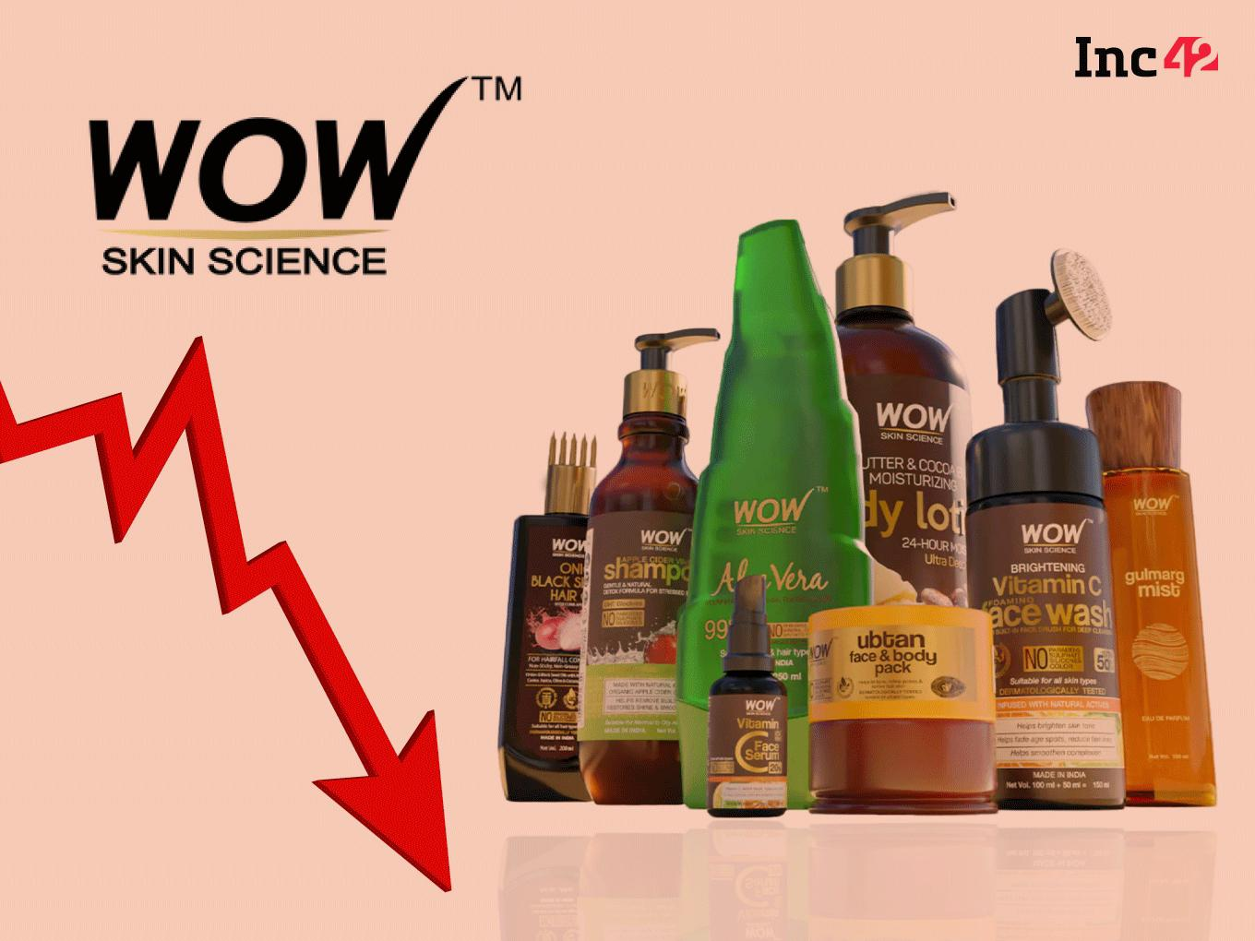
Presented by
Team ID :
LTVIP2024TMID10421 Team Leader :
PANCHADI ANITHA Team member :
LOTTI PAVANI PAIDI KALYANI PEDALAPU RAJESWARI PATIVADA RENUKA

Slide 3

Logo of wow cosmetics

Slide 4
Introduction
Wow Cosmetics" was established in 2010 by a team of beauty enthusiasts dedicated to providing high-quality, innovative cosmetic products to enhance the natural beauty of their customers. Since its inception, Wow Cosmetics has become a trusted name in the beauty industry, known for its commitment to quality, diversity, and affordability. With a wide range of skincare, makeup, and beauty accessories, Wow Cosmetics continues to inspire individuals worldwide to express themselves confidently through the art of makeup.

Slide 5
Wow Skin Science offers a diverse range of skincare products infused with natural ingredients to cater to various skin concerns. From cleansers and moisturizers to serums and masks, each product is meticulously formulated to deliver effective results while being gentle on the skin. With a commitment to using potent botanicals and cutting-edge technology, Wow Skin Science products aim to enhance skin health and radiance, promoting a naturally beautiful complexion for all skin types.

Slide 6
Part :-1
Brand study, Competitor Analysis & Buyer’s/Audience’s persona

Slide 7
Brand Study(MissIon/Values And usp)
To conduct a brand study for Wow Cosmetics, we need to explore its mission, values, and unique selling proposition (USP).
Mission& values:
Wow Cosmetics aims to empower individuals to express their unique beauty confidently through innovative and high-quality cosmetic products.Innovation: Wow Cosmetics is committed to continuous innovation in product development, staying ahead of trends, and providing customers with cutting-edge cosmetic solutions
Quality: The brand prioritizes the use of high-quality ingredients and rigorous testing processes to ensure the efficacy and safety of its products
Inclusivity: Wow Cosmetics celebrates diversity and inclusivity, offering a wide range of products suitable for all skin types, tones, and preferences.Sustainability: Environmental responsibility is integral to Wow Cosmetics’ ethos, with efforts to minimize its ecological footprint through eco-friendly packaging and sustainable practices.Empowerment: Wow Cosmetics seeks to empower individuals by enhancing their confidence and self-expression through makeup.

Slide 8
Unique Selling Proposition (USP): Wow Cosmetics stands out in the market for its combination of cutting-edge innovation, high-quality ingredients, and commitment to inclusivity and empowerment. Its USP lies in offering cosmetics that not only meet the highest standards of quality and performance but also cater to diverse needs and preferences, allowing customers to embrace their individuality with confidence. Additionally, the brand’s dedication to sustainability appeals to environmentally conscious consumers, further differentiating it from competitors.

Slide 9
Brand study(Brand tone & Kip) wow cosmetics
To conduct a brand study for Wow Cosmetics, you’ll want to delve into several key areas: Brand Tone: Visual Identity: Assess the design elements, such as logo, colors, and packaging, to understand the brand’s visual tone. Messaging: Review the language used in advertising, social media, and other communication channels to determine the brand’s voice and personality. Target Audience: Analyze the brand’s target demographic and tailor the tone to resonate with them. Consistency: Ensure that the brand tone is consistent across all touchpoints to maintain brand identity and integrity.

Slide 10
Key Performance Indicators (KPIs)
Sales Revenue: Tracking overall revenue generated from Wow Cosmetics products. Customer Acquisition Cost (CAC): Monitoring the cost to acquire new customers. Customer Lifetime Value (CLV): Assessing the total value a customer brings to the brand over their lifetime. Social Media Engagement: Measuring likes, comments, shares, and overall engagement on social media platforms. Brand Awareness: Tracking metrics such as website traffic, search volume, and social media mentions to gauge brand visibility.

Slide 11
Buyer/ audience Person:-
To create a buyer/audience persona for Wow Cosmetics, we’d need to consider demographics, interests, behaviors, and pain points of potential customers. Here’s a basic outline: Name: Sarah Age: 30 Occupation: Marketing Manager Psychographics: Lifestyle: Busy professional, values self-care and personal grooming. Interests: Follows beauty influencers on social media, enjoys trying new makeup trends. Values: Quality, convenience, and efficacy in beauty products. Personality: Confident, trendy, and always looking for ways to enhance her appearance.

Slide 12
Behavior:Regularly shops online for cosmetics.Actively engages with beauty content on social media platforms like Instagram and YouTube.Seeks out reviews and recommendations before making a purchase.Prefers products that offer both style and substance.
Goals: Achieve a polished look for work and social events.Stay up-to-date with the latest beauty trends.Simplify her beauty routine without sacrificing quality.Find cosmetics that complement her skin tone and type
Challenges:Limited time for elaborate beauty routines.Difficulty finding products that match her specific skin tone and preferences.Unsure about which products are best suited for her skin type.Concerned about the environmental impact of beauty products.Understanding Sarah’s needs, preferences, and pain points will help “Wow Cosmetics” tailor their products, marketing messages, and customer experiences to effectively resonate with her.

Slide 13
Goals for wow cosmetics
Wow Skin Science products aim to revolutionize skincare by combining the power of nature with innovative science. With a focus on delivering effective solutions for diverse skin concerns, their goals encompass promoting skin health, rejuvenation, and radiance. Whether it’s addressing acne, aging, hydration, or brightening, Wow Skin Science strives to offer products that harness the potency of natural ingredients to deliver visible results. By prioritizing quality, efficacy, and sustainability, Wow Skin Science seeks to empower individuals to achieve their skincare goals while embracing the beauty of natural ingredients.

Slide 14
Advantages of wow cosmetics
Natural Ingredients: Wow Skin Science products harness the power of natural ingredients, which can be gentle yet effective on the skin.
Diverse Range: The brand offers a wide array of products catering to various skin concerns, from acne and aging to hydration and brightening.
Visible Results: Users often report visible improvements in theiNatural Ingredients: Wow Skin Science products harness the power of natural ingredients, which can be gentle yet effective on the skin.
Quality Assurance: Wow Skin Science prioritizes quality and efficacy, ensuring that each product meets rigorous standards and delivers consistent results.
Sustainable Approach: The brand is committed to sustainability, utilizing eco-friendly packaging and responsibly sourced ingredients, appealing Science products, thanks to their potent formulations.
s consumers.

Slide 15
Disadvantages of wow cosmetics
Potential Sensitivities: Some individuals may experience skin reactions or sensitivities to certain natural ingredients used in Wow Skin Science products. Limited Availability: Depending on geographic location, access to Wow Skin Science products may be limited, posing a challenge for potential customers in certain regions. Price Range: While the brand offers quality products, some consumers may find the price range of Wow Skin Science items to be higher compared to other skincare options. Ingredient Preferences: Users with specific ingredient preferences or requirements may find that Wow Skin Science products do not align with their preferences, as the brand primarily focuses on natural ingredients. Effectiveness Variability: As with any skincare brand, individual results may vary, and some users may not experience the desired outcomes with Wow Skin Science products despite the brand’s claims of efficacy.

Slide 16
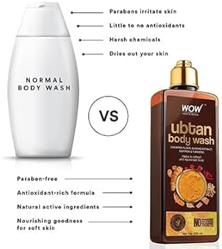
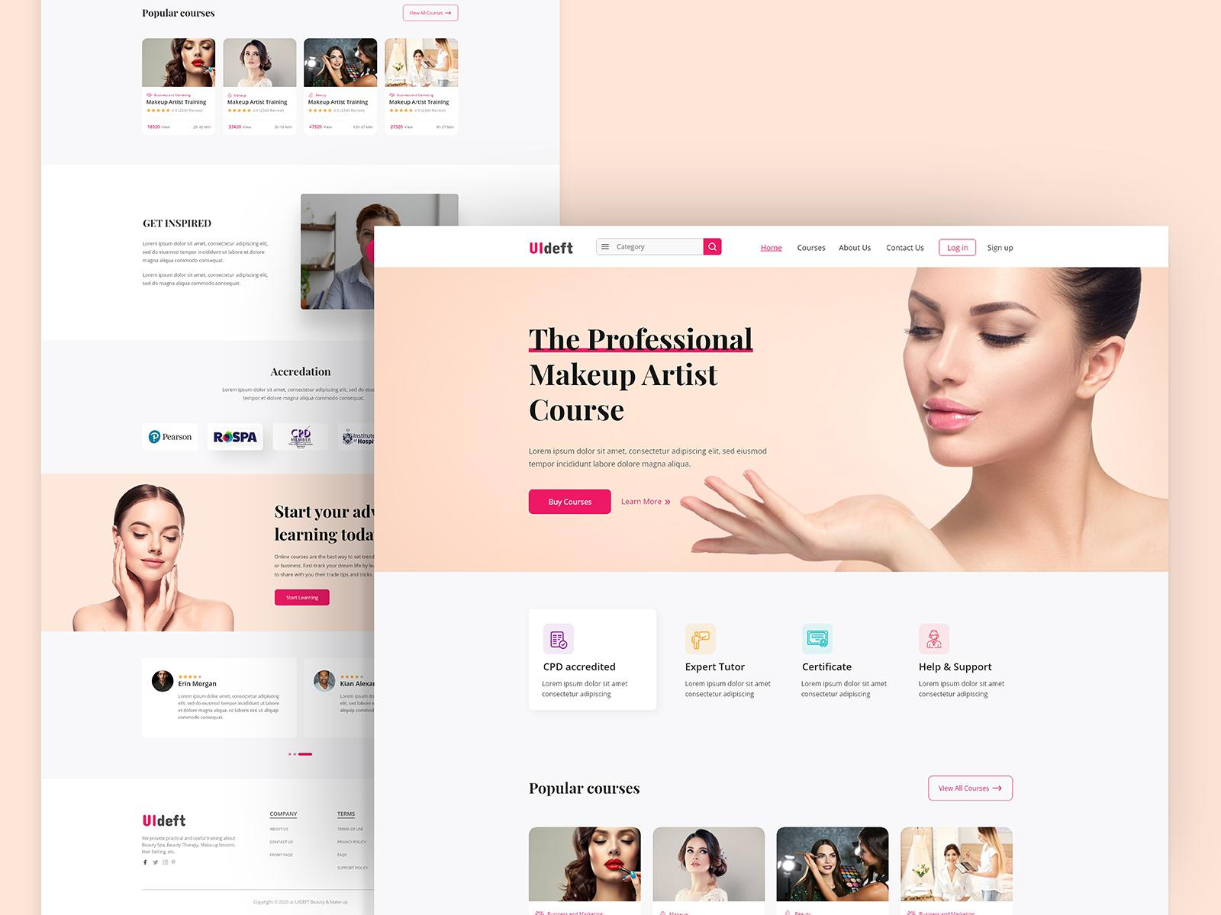

Slide 17
Brand study, Competitor Analysis & Buyer’s/Audience’s Persona
Competitor 1: Maybelline New York: Unique Selling Points (USPs): Wide range of products catering to diverse skin tones and preferences. Strong brand recognition and presence in the Indian market. Affordable pricing compared to high-end competitors. Innovative product launches and collaborations with influencers. Online Communication: Active presence on social media platforms like Instagram and YouTube, showcasing product tutorials, reviews, and user-generated content. Engaging with followers through interactive campaigns, contests, and polls. Regular updates on new launches, promotions, and discounts.

Slide 18
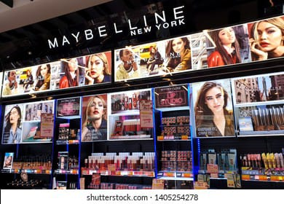
SWOT Analysis: Strengths: Strong brand equity, diverse product range, effective online marketing. Weaknesses: Competition from both high-end and budget-friendly brands, occasional criticism for product quality. Opportunities: Expanding product lines to cater to specific customer needs, tapping into emerging trends like clean beauty and sustainability. Threats: Intense competition from both domestic and international brands, shifting consumer preferences, economic downturns impacting consumer spending.

Slide 19
Competitor 2: Lakme: Unique Selling Points (USPs): Strong association with Bollywood celebrities, enhancing brand image and appeal. Focus on skincare products in addition to makeup, tapping into the growing demand for holistic beauty solutions. Availability in a wide range of retail outlets across India, including both urban and rural areas. Online Communication: Collaborations with beauty influencers and makeup artists to create buzz around product launches and trends. Regular updates on social media platforms with a mix of product promotions, behind-the-scenes content, and beauty tips. Utilizing digital platforms for virtual try-on experiences and personalized recommendations.

Slide 20
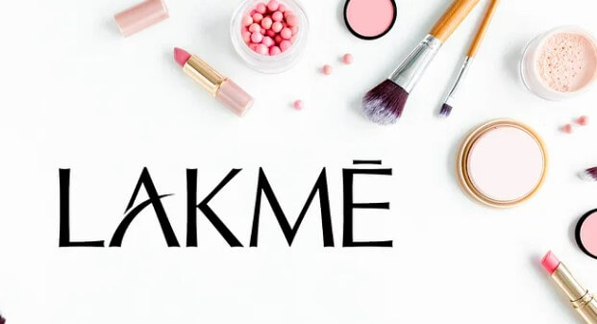
SWOT Analysis: Strengths: Celebrity endorsements, wide distribution network, focus on skincare. Weaknesses: Perception of being slightly more expensive than some competitors, occasional criticism for product formula changes. Opportunities: Expanding into new product categories like clean beauty, leveraging digital platforms for e-commerce growth. Threats: Competition from both domestic and international brands, changing consumer preferences towards natural and organic products.

Slide 21
Competitor 3: Nykaa: Unique Selling Points (USPs): Nykaa offers a wide selection of beauty and wellness products from various brands, including their own private label. Strong online presence with a user-friendly e-commerce platform, making it convenient for customers to discover and purchase products. Exclusive collaborations and limited edition releases, creating a sense of exclusivity and urgency among customers. Online Communication: Active engagement on social media platforms with a focus on user-generated content, reviews, and tutorials. Regular updates on new product launches, promotions, and sales events. Utilization of influencer marketing to reach a wider audience and drive sales.

Slide 22

SWOT Analysis: Strengths: Diverse product range, strong online platform, exclusive collaborations. Weaknesses: Relatively new in comparison to traditional cosmetic brands, dependency on e-commerce. Opportunities: Expanding product categories beyond cosmetics, enhancing offline presence through brick-and-mortar stores. Threats: Competition from established brands, potential backlash from customers over product quality or delivery issues. These analyses provide insight into the competitive landscape of the cosmetics industry in India and highlight each competitor’s strengths, weaknesses, opportunities, and threats.

Slide 23
Part:-2
SEO & Keyword Research

Slide 24
SEO KEYWORD RESEARCH
Backlink Profile: Analyze the backlink profile for quality and relevance, identifying opportunities for link building and removing any toxic or spammy links. Competitor Analysis: Study the SEO strategies of competitors in the cosmetics industry to identify strengths, weaknesses, and opportunities for improvement. User Experience (UX): Review the website’s usability, navigation, and overall user experience, ensuring it’s easy for visitors to find what they’re looking for and complete conversions. Acal SEO: If Wow Cosmetics has physical stores, ensure their local SEO is optimized withaccurate NAP (Name, Address, Phone) information and local business citations. Social Media Integration: Evaluate how well Wow Cosmetics is utilizing social media platforms for SEO, including sharing content, engaging with customers, and building brand authority.

Slide 25
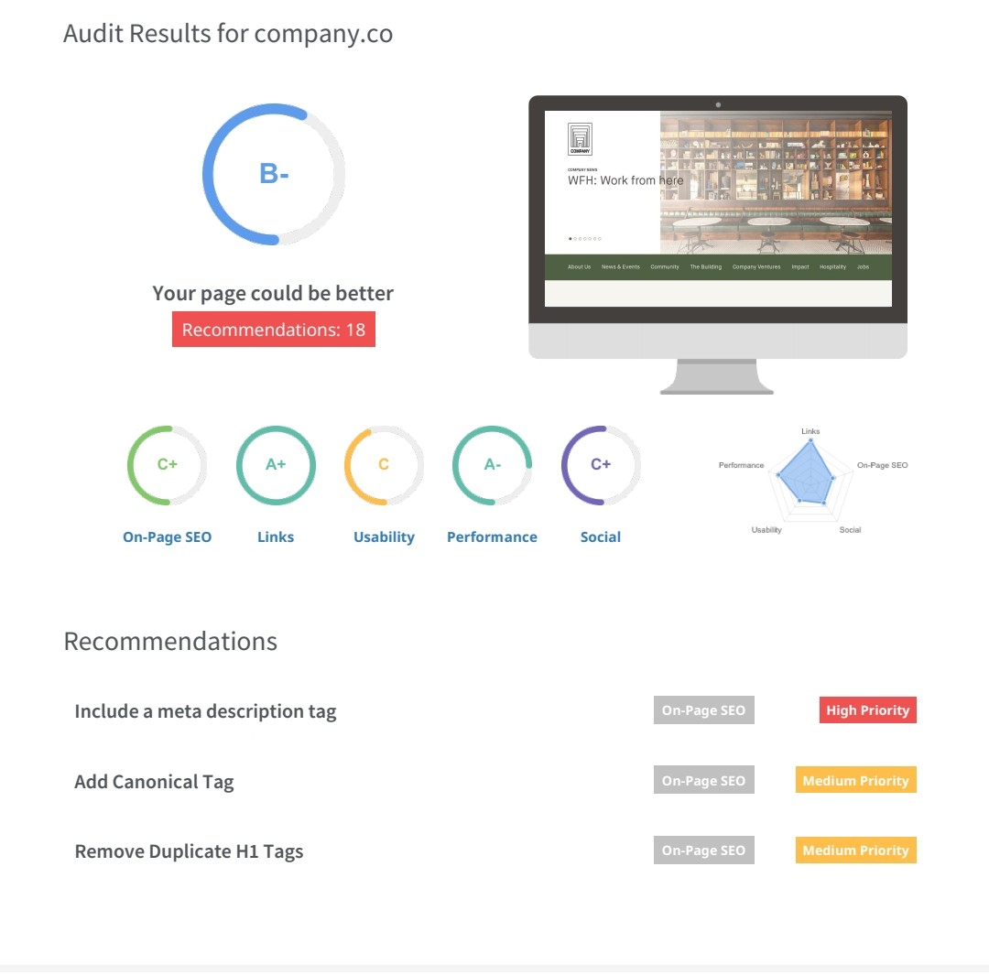
SEO audit of wow cosmetics
Keyword Optimization: Conduct thorough keyword research to identify relevant search terms related to skincare, focusing on both product-specific and informational keywords. Optimize website content, including product descriptions, blog posts, and meta tags, to incorporate these keywords naturally and improve search engine visibility. Technical SEO: Ensure proper website structure, including fast loading times, mobile responsiveness, and optimized URL structures. Address any crawlability issues by submitting an updated XML sitemap to search engines, and fix any broken links or redirect errors. Additionally, optimize images for faster loading and better user experience.

Slide 26
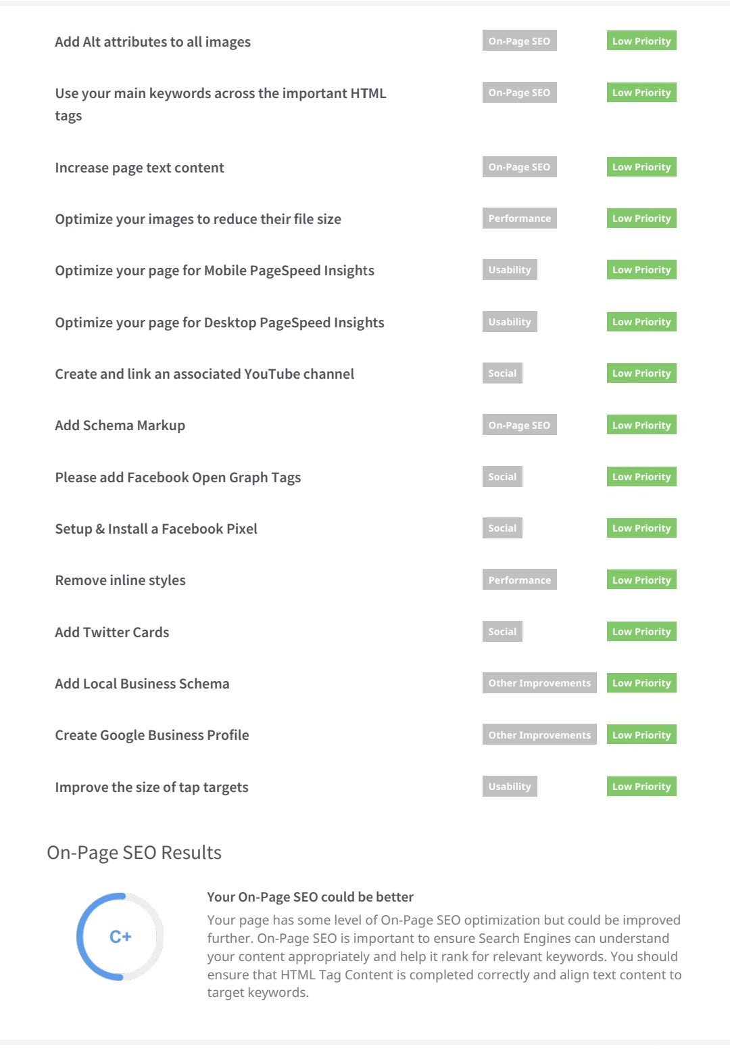
SEO audit

Slide 27
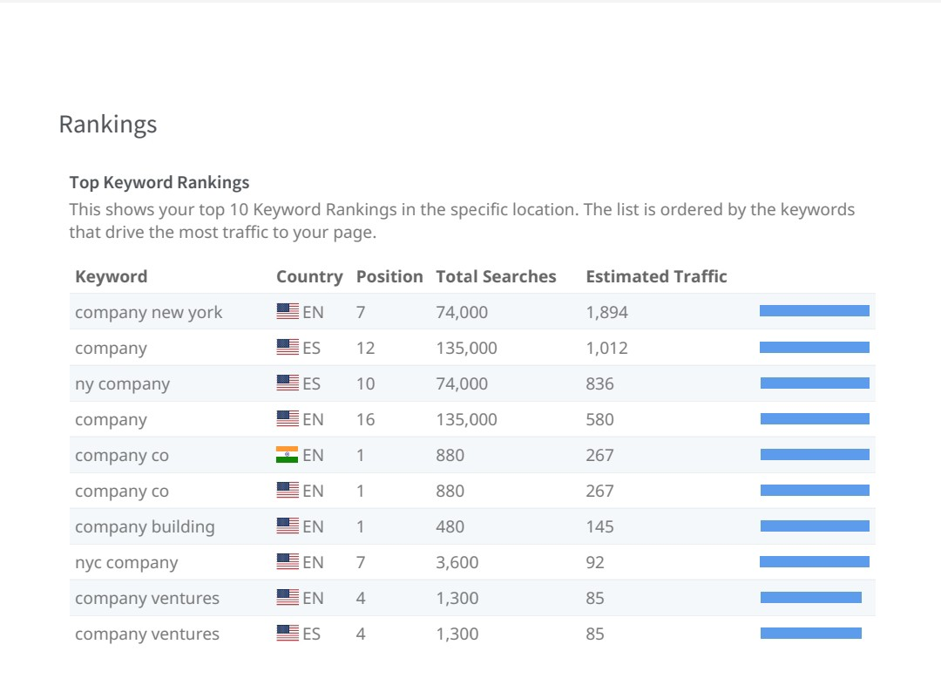
Keyword research of wow cosmetics

Slide 28
On page optimization of wow cosmetics
Understanding Your Skin Type: Identify your skin type (normal, oily, dry, combination, sensitive) to choose products that cater to your specific needs.
Consistent Routine: Establish a daily skincare routine using WOW products tailored to your skin type. Consistency is key for seeing optimal results.
Patch Testing: Before applying any new product all over your face, perform a patch test on a small area of skin to check for any adverse reactions or allergies.
Follow Instructions: Read and follow the instructions provided with each product carefully to ensure correct application and usage frequency.
Complementary Products: Consider using WOW Skin Science products that complement each other for a synergistic effect. For example, pairing a cleanser with a toner and moisturizer from the same line can enhance results.

Slide 29
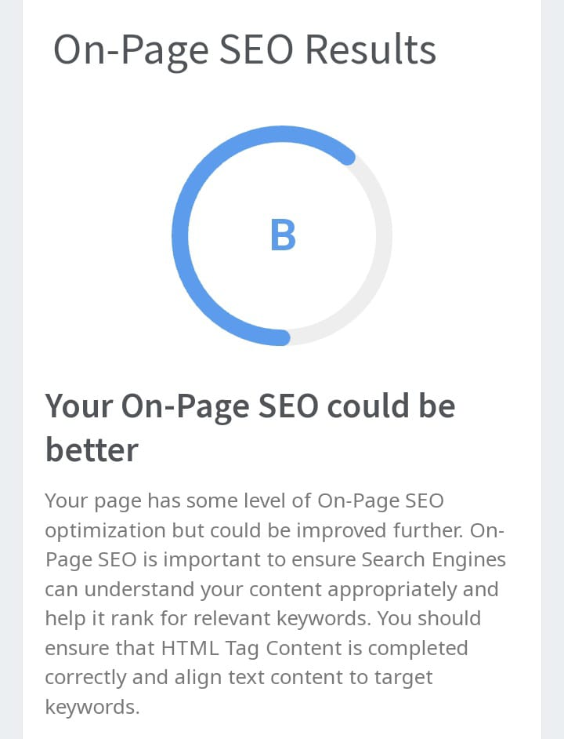
On-page Seo results

Slide 30
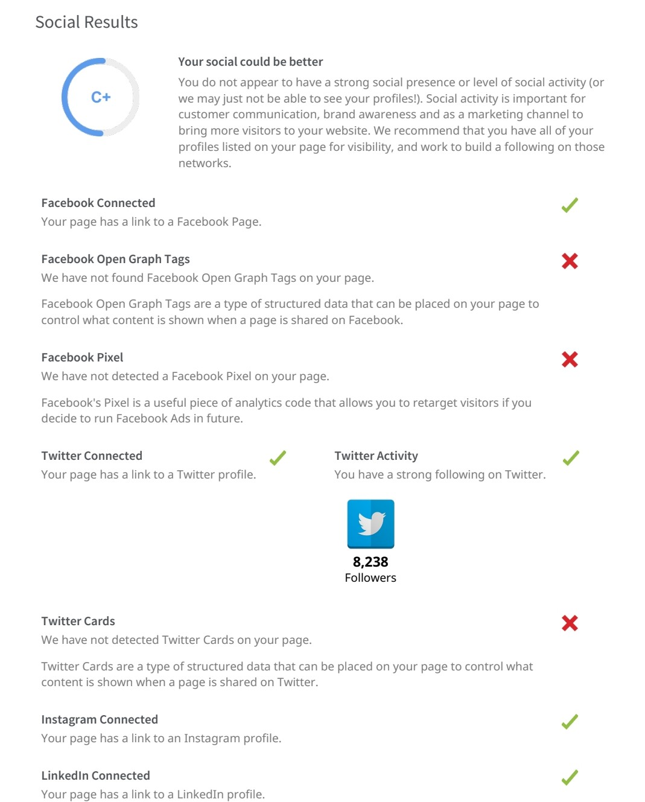
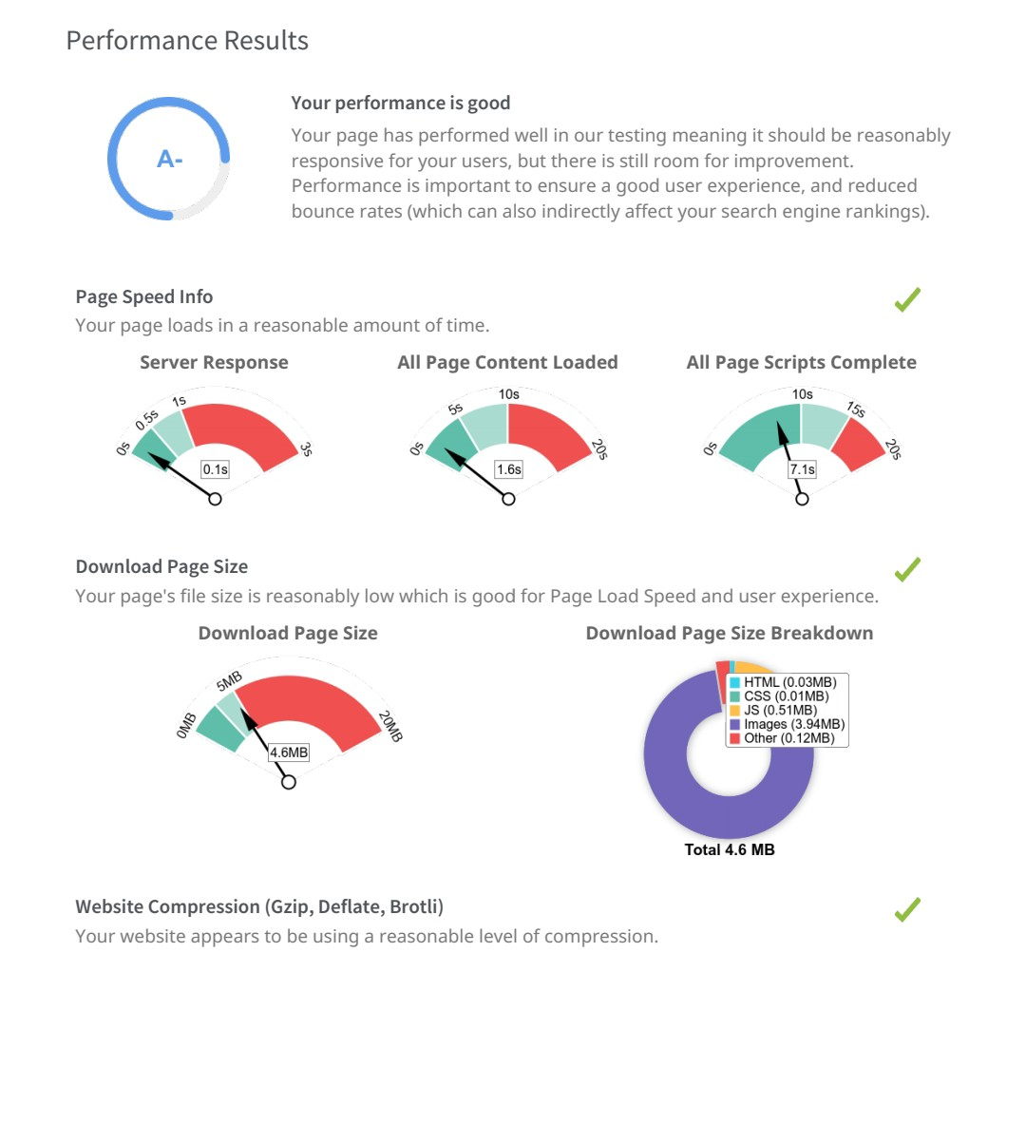

Slide 31
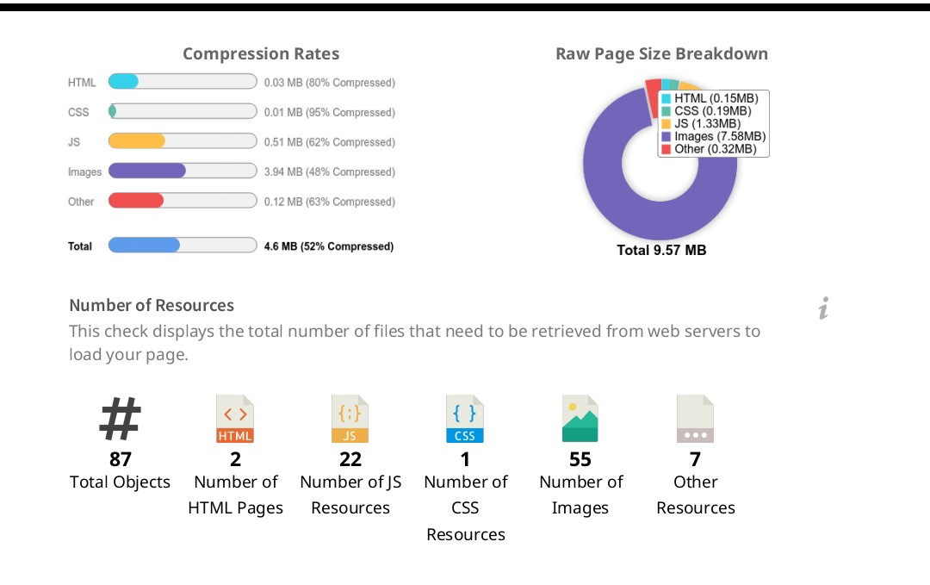
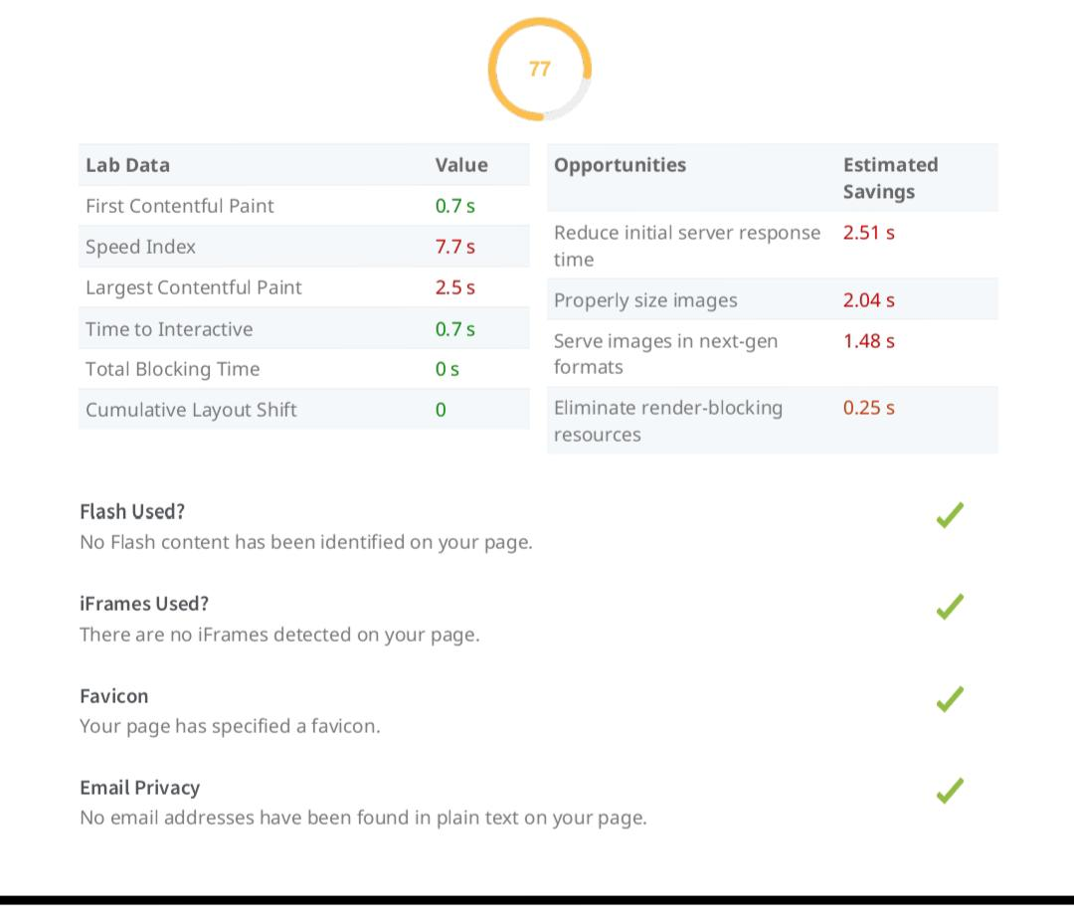

Slide 32
Part :-3
Content Ideas and Marketing Strategies

Slide 33
Content Ideas and Marketing Strategies
Marketing strategies
Social Media Advertising: Utilize targeted advertising on platforms like Facebook, Instagram, and TikTok to reach potential customers based on demographics, interests, and behavior. Engaging visuals and compelling messaging will help drive conversions. Email Marketing Campaigns: Build an email list of subscribers and send out regular newsletters featuring product launches, promotions, makeup tips, and exclusive offers. Personalize the content to cater to different customer segments and encourage repeat purchases. Brand Ambassadors Program: Recruit passionate fans of your brand as brand ambassadors to represent Wow Cosmetics online and offline. Offer them perks such as early access to new products, exclusive discounts, and opportunities to collaborate on content creation.
Content ideas
Interactive Packaging: Create packaging that engages customers, like QR codes leading to tutorials or AR experiences showcasing the product. Eco-Friendly Initiatives: Embrace sustainability by using recycled materials for packaging or offering refills to reduce waste. Limited Edition Collaborations: Partner with artists, influencers, or even other brands for exclusive, limited-edition collections to generate buzz and attract new customers.

Slide 34
Content Ideas and Marketing Strategies
Content Ideas
Personalized Products: Offer customizable options such as shade-matching services or monogrammed packaging to make customers feel special and unique. Community Engagement: Build a community around your brand through social media challenges, user-generated content, and events to foster a sense of belonging and loyalty. Ingredient Transparency: Highlight the natural and beneficial ingredients in your products, educating customers on their benefits and ensuring transparency about what goes into each item.
Marketing Strategies
Influencer Partnerships: Collaborate with beauty influencers and makeup artists to showcase your products through tutorials, reviews, and sponsored content on social media platforms like Instagram and YouTube. User-Generated Content Campaigns: Encourage customers to share their makeup looks using your products with branded hashtags, and feature their content on your social media channels or website. This builds community and authenticity around your brand. Pop-Up Shops and Events: Host pop-up shops in high-traffic areas or partner with beauty expos and events to give customers a chance to experience your products in person, try out samples, and interact with your brand ambassadors.

Slide 35
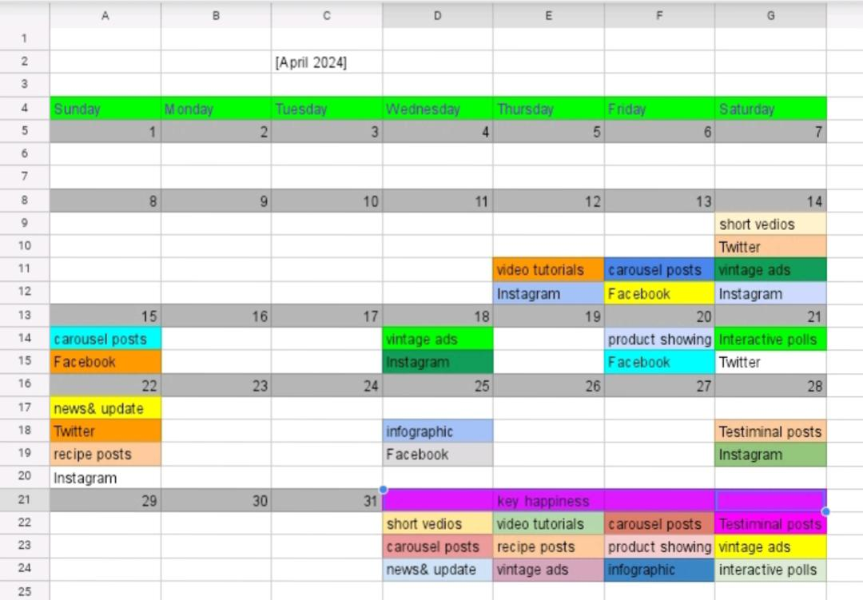
CONTENT CALENDAR

Slide 36
Part 4:
Content Creation and Curation

Slide 37
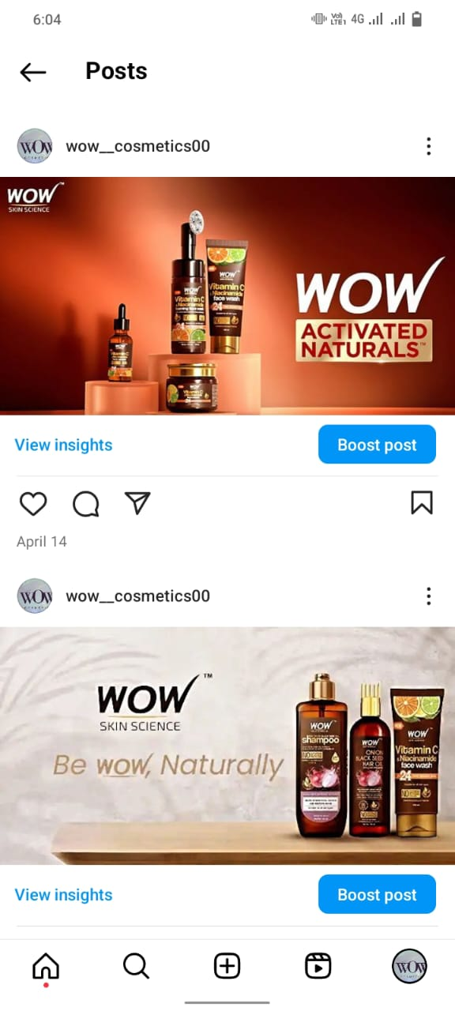
Post creation
Format 1 – advertising post of wow cosmetics.
Hastage#:-wow cosmetics. #wow hair shampoo.
Contant ideas:- the wow cosmetics gives u freshness.
Caption:- use the wow cosmetics and feel fresh 🍃💦.

Slide 38
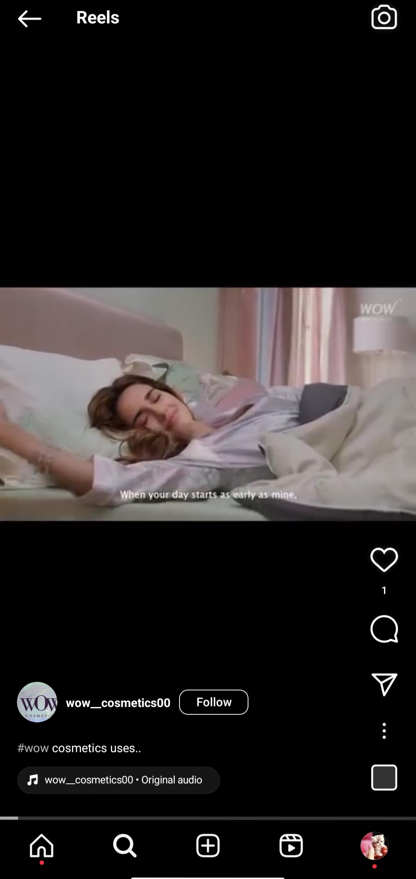
Format 2 – Reel Post on Wow cosmetics
Caption:use the wow cosmetics products and get glow to your life
Hashtags:#wow cosmetics #cool wow # wow products.

Slide 39
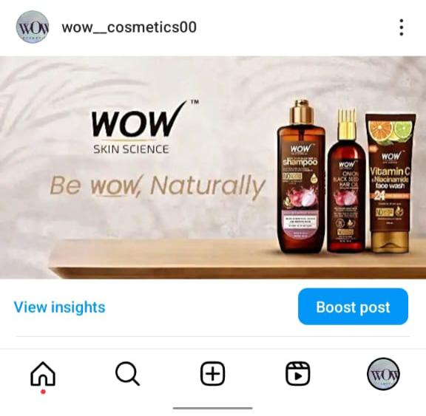
Format 3 – Carousel Post on wow cosmetics
Caption: use the wow cosmetics and add happiness to your life.
Hashtags:-Wow cosmetics # needed cosmetics.

Slide 40
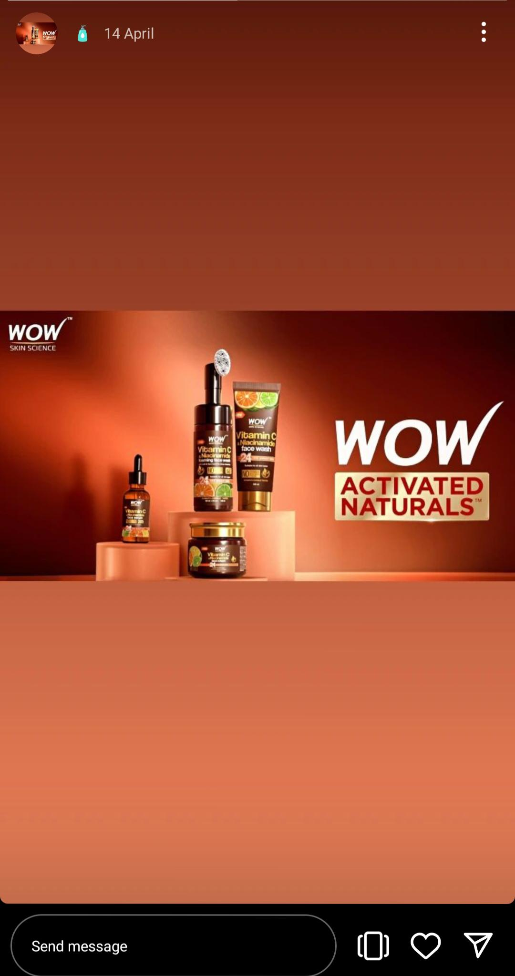
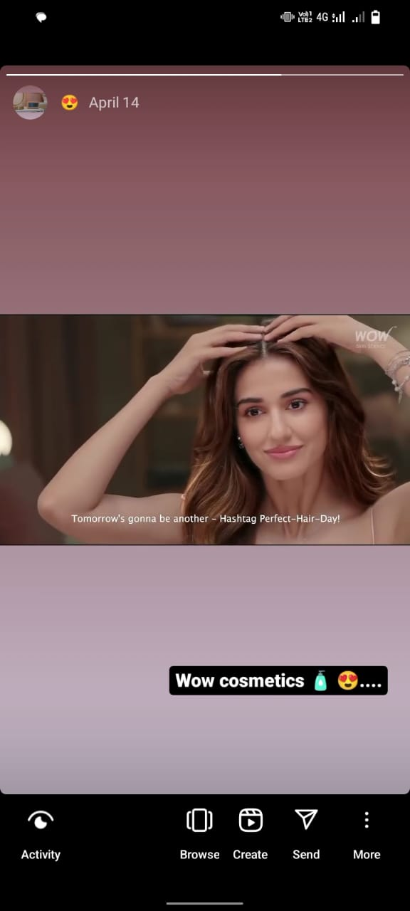
Instagram story
Screen shots of Instagram story and link.:-
https://www.instagram.com/s/aGlnaGxpZ2h0OjE4MDA5NzkxODk3MTQ4NTQy?story_media_id=3346004965003872794_62301225794&igsh=NGsxeWFzaHR6N3N2

Slide 41
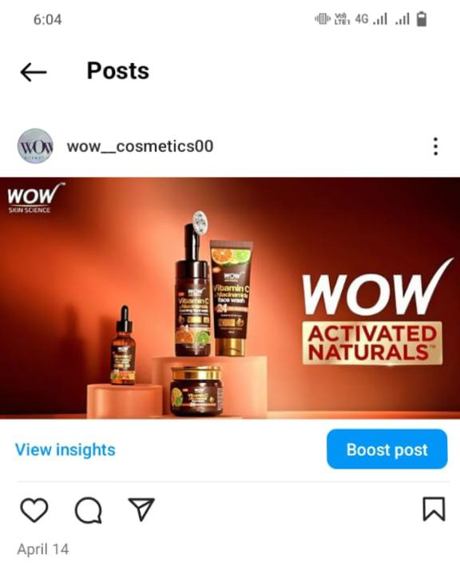
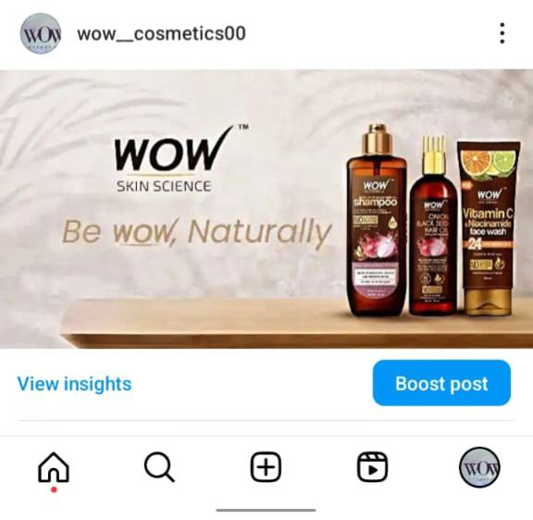
Post link and screen shot :-
https://www.instagram.com/p/C5vY8k0vxXo/?igsh=MWZtbHR5bWoxc2syYQ==

Slide 42
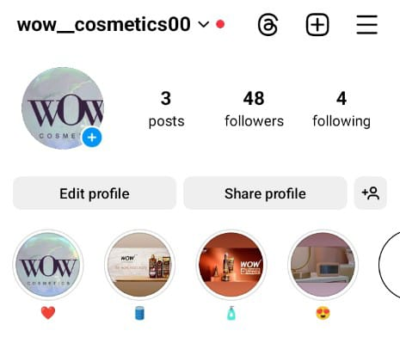
Highlights

Slide 43
Instagram I’d link
https://www.instagram.com/wow__cosmetics00?utm_source=qr&igsh=MTlsdnlndnU3OGlsZg==

Slide 44
Instagram links:-
Instagram I’d link:-https://www.instagram.com/wow__cosmetics00?utm_source=qr&igsh=MTlsdnlndnU3OGlsZg==
Instagram post link:-￼https://www.instagram.com/p/C5vY8k0vxXo/?igsh=MWZtbHR5bWoxc2syYQ== ￼￼￼￼￼￼￼￼￼￼￼￼￼￼￼￼￼￼￼￼￼￼￼￼￼￼￼￼￼￼￼￼￼￼￼￼￼￼￼￼￼￼￼￼￼￼￼￼￼￼￼￼￼￼￼￼￼￼￼￼￼￼￼￼￼
Instagram story link:-https://www.instagram.com/s/aGlnaGxpZ2h0OjE4MDA5NzkxODk3MTQ4NTQy?story_media_id=3346004965003872794_62301225794&igsh=NGsxeWFzaHR6N3N2

Slide 45


